Slide 1
HTML5 & Css3 Day1
ENG. Nawal Zaki Abdelhadi
iTi Staff

Slide 2
Introduction
1

Slide 3
XHTML is a documents must be marked up correctly &well-formed

Slide 4

What is XHTML ?
XHTML stands for “Extensible Hyper Text Mark-up Language”.
XHTML is a new and more well-structured way of writing HTML.
XHTML Versions
XHTML 1.0 became a W3C on January 26, 2000.
XHTML 1.1 became a W3C on May 31, 2001.

Slide 5
What is XHTML ?
XHTML5 is undergoing development as of September 2009, as part of the HTML5 specification.
XHTML consists of all the elements in HTML 4.01, combined with the strict syntax of XML.

Slide 6
What is Rules of XHTML ?
Attribute minimization is forbidden. e.g. checked="checked".
The id attribute replaces the name attribute.
The XHTML DTD defines mandatory elements.
i.e. <!DOCTYPE html> Is Mandatory
It is not an HTML tag & does not have an end tag

Slide 7
HTML5 is a chance to Do things Differently

Slide 8
What is HTML5?
HTML5 will be the new standard for HTML.
The previous version of HTML, HTML 4.01, came in 1999. The web has changed a lot since then.
HTML5 is still a work in progress. However, the major browsers support many of the new HTML5 elements and APIs.

Slide 9
What is HTML5?
HTML5 is a cooperation between the World Wide Web Consortium (W3C) and the Web Hypertext Application Technology Working Group (WHATWG).
WHATWG was working with web forms and applications, and W3C was working with XHTML 2.0. In 2006, they decided to cooperate and create a new version of HTML.

Slide 10
HTML5….
HTML5
HTML
CSS
JavaScript
=
+
+

Slide 11
HTML5….
<!DOCTYPE html>
<html>
<head>
<title>Title of the document</title>
</head>
<body>
//The content of the document......
</body>
</html>
Let’s Try it …

Slide 12
HTML5 Meta Tag
2

Slide 13
Charest….
To display an HTML page correctly, a web browser must know the character set used in the page
//For HTML 4
<meta http-equiv="Content-Type" content="text/html;charset=ISO-8859-1">
//For HTML 5
<meta charset="UTF-8">

Slide 14
Charest….
To display an HTML page response
//For HTML 5
<meta name="viewport" content="width=device-width, initial-scale=1.0">

Slide 15
HTML5 Forms
3

Slide 16
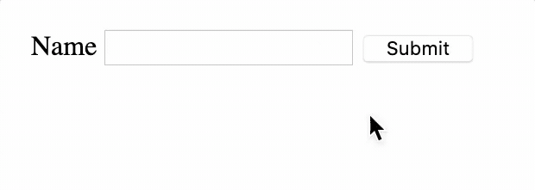
Required …
<form>
<input type="text" required/>
</form>
Required: We also have required attribute to mark this field as mandatory.

Slide 17
Multiple and Pattern …
<form>
<input type="text" multiple/>
</form>
Multiple: allows the user to enter multiple email addresses.
<form>
<input type="text" pattern=“[0-9][A-Z]{3}”/>
</form>
Pattern: custom validate,
A part number is a digit
followed by three uppercase
letters.

Slide 18
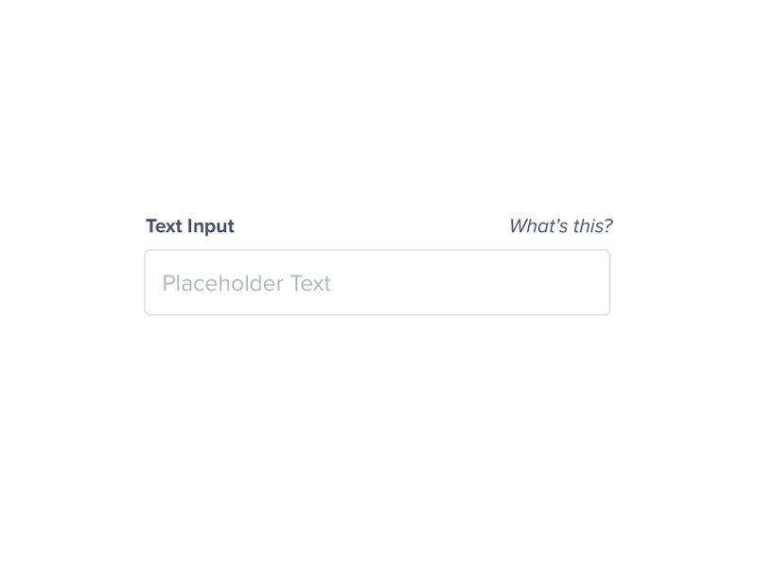
Placeholder …
<form>
<input type="text" placeholder=“Enter Your Name” >
</form>
Placeholder: add a hint inside the text-field, but where the hint
automatically disappears when clicking inside it.

Slide 19
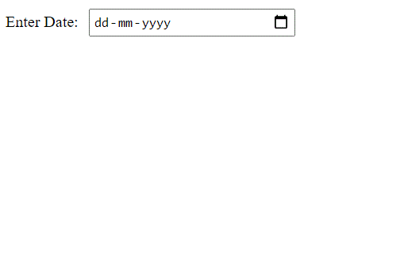
Dates and Times …
<input type="datetime“>
<input type="datetime-local">
<input type=“date“>
<input type=“month“>
<input type=“week“>

Slide 20
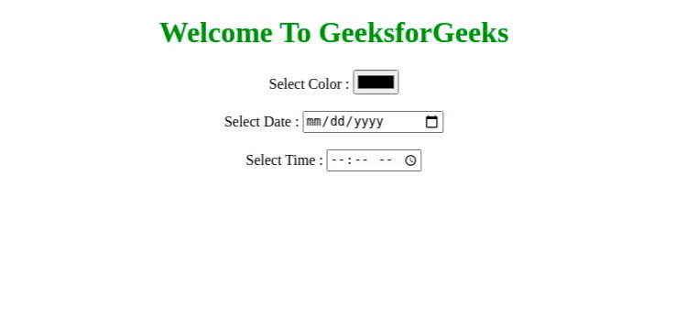
Dates and Times …
<input type="time“>

Slide 21

Search …
<input type=“search“>

Slide 22
Color …
<input type=“color”>

Slide 23
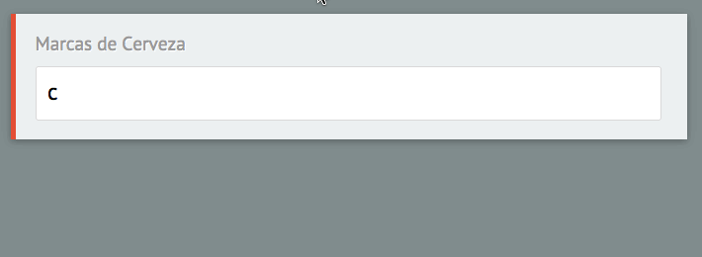
Combo Boxes (datalist) …
<input list="title-list">
<datalist id="title-list">
<option value="...">
</datalist>

Slide 24
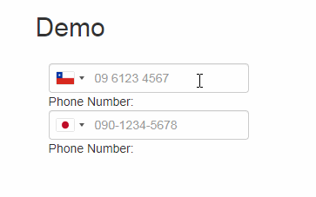
Telephone …
<input type=“tel”>

Slide 25
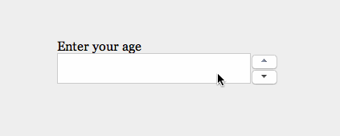
Number …
<input type=“number”>

Slide 26
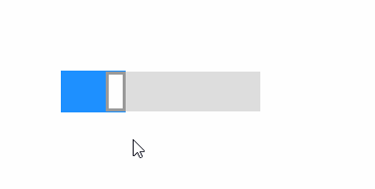
Range …
<input type=“range”>

Slide 27
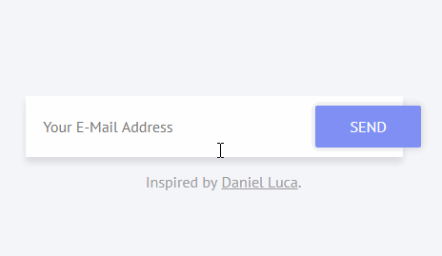
Email …
<input type=“email”>
<input type=“url”>

Slide 28
Form Attributes …
New attributes for <form>:
1) autocomplete 2) novalidate
New attributes for <input>:
1) Autocomplete 2) autofocus 3) form 4) formaction
5) formenctype 6) formmethod 7) formnovalidate
8) formtarget 9) height and width 10) list
11) min and max 12) multiple 13)pattern (regexp)
14) placeholder 15) required 16) step

Slide 29
HTML 5 Semantic Elements
4

Slide 30
Semantic Means….
When people say they want to make something more semantic, they simply want to make that thing more meaningful.
Semantic html is using html to reinforce structural meaning. It’s about using tags, class names, and ids that reinforce the meaning of the content within the tags.

Slide 31
Why Semantic HTML is Important….
Clean: It’s easier to read and edit, which saves time and money during maintenance.
More accessible: It can be better understood by a greater variety of devices.
Search engine friendly: This is still debatable as search engines rank content and not code.

Slide 32
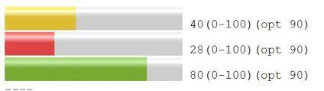
Meter …
Representing scalar measurements or fractional values.
Meter is also known as a gauge.
It should not be used to indicate progress.
Attributes:
1) value 2) min
3) max 4) high
5) low 6) optimum
<meter value="0.6“ min=“” max=“” high ="0.6“ > Medium </meter>

Slide 33
Progress …
Show completion progress of a task.
Progress bars are widely used in other applications
Works with scripted applications.
Attributes :
1) value : Specifies how much of the task has been completed
2) max : Specifies how much work the task requires in total.
Useful for:
Indicate loading progress of an AJAX application
Show user progress through a series of forms
Making impatient users wait

Slide 34
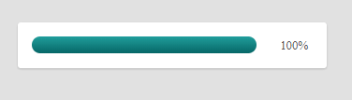
Progress …
<progress id=“pBar" max="100" value=“10"> </progress>

Slide 35
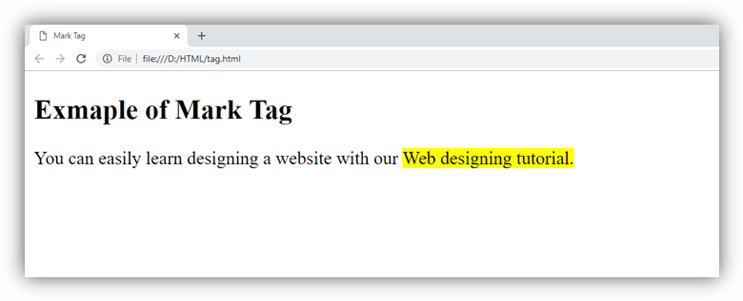
Mark …
Marked or Highlighted text
Indicates point of interest or relevance
Useful for:
Highlighting relevant code in a code sample
Highlighting search keywords in a document (e.g. in Google Cache)
<mark> welcome </mark>

Slide 36
Time …
Time as you would expect is used to markup temporal information.
It can be used for dates, times, or combinations of the two.
The <time> tag defines either a time (24 hour clock), or a date in the Gregorian calendar, optionally with a time and a time-zone offset.
This element can be used as a way to encode dates and times in a machine-readable way.
<time>2011-07-14</time>
<time datetime="2011-07-14">July 14th, 2011</time>
<time datetime="2011-07-14T14:00">2pm on July 14th</time>

Slide 37
HTML 5 Structural Elements
5

Slide 38
Structural Elements …
Structural Semantic Elements:
<header>
<hgroup>
<nav>
<section>
<article>
<aside>
<footer>
<address>

Slide 39
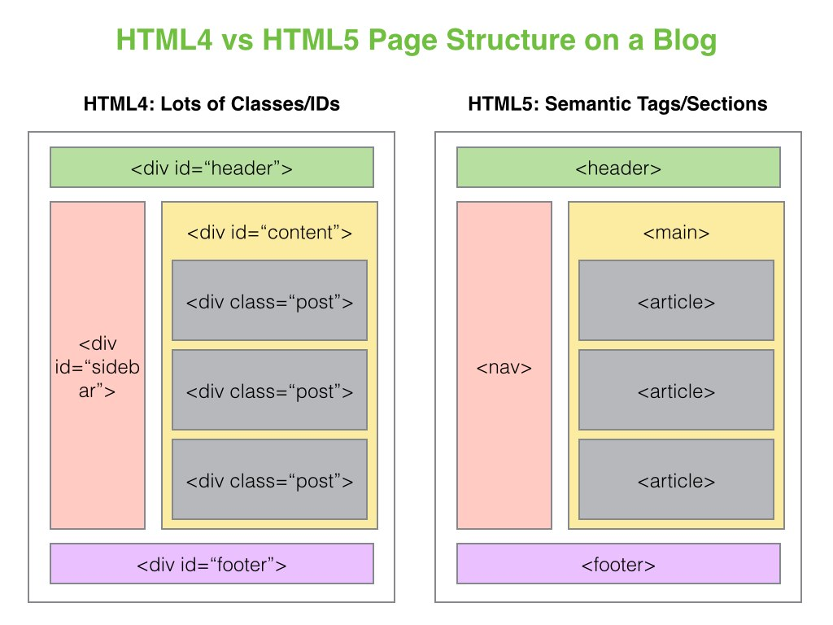
Structural Elements …

Slide 40
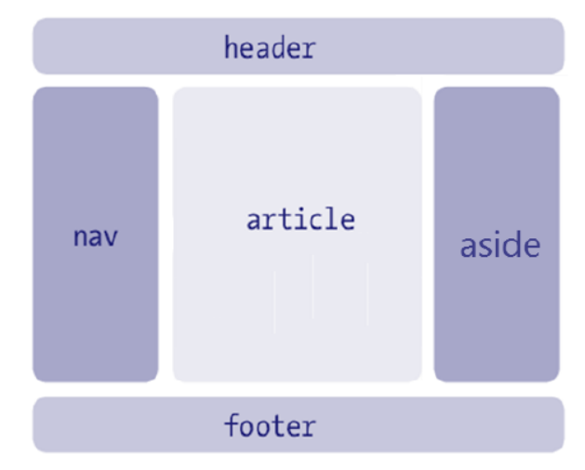
Structural Elements …

Slide 41
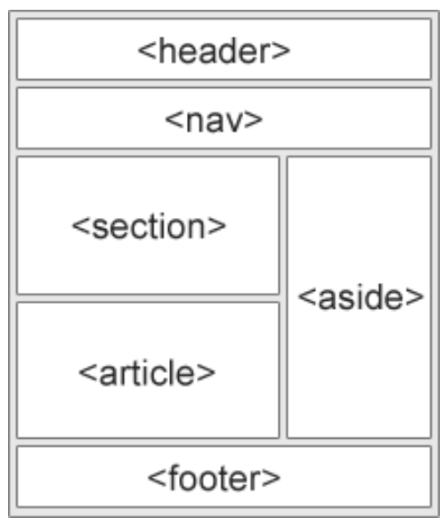
Structural Elements …

Slide 42


Self Study
Microdata

Slide 43
HTML 5 Multimedia
6

Slide 44
Multimedia …
No need for plugin to play video and audio HTML 5 will do it for you.
HTML5 offers the ability to easily embed media into HTML documents.
Media playback can be controlled via JavaScript and media events.
Nothing to install.
Works in all browsers and phones (adding native support to browsers).

Slide 45
Multimedia …
Media Attributes
Description | Attribute
Specifies the URL of the media source file | src
Specifies whether or not to display media controls (such as a play/pause button etc) | controls
Specifies whether or not to start playing the media as soon as it has been loaded. | autoplay
Specifies whether to keep re-playing the media once it has finished. | loop
display a frame of the video (as a .jpg, .png..) | poster=“”
Specifies the width, in pixels, to display the video. | width=“”
Specifies the height, in pixels, to display the video. | height=“”

Slide 46
Multimedia …
Media Methods & Properties
Description | Method
Re-loads the audio/video element | load()
Starts playing the audio/video | play()
Pauses the currently playing audio/video | pause()
1) controls 2) loop 3) autoplay 4) played
5) paused 6) ended 7) playbackRate
8) currentTime 9) src 10) muted 11) volume

Slide 47


